Slide 1
ONLINE PHARMACY
MANAGEMENT SYSTEM
IN
JAVA MYSQL
GUIDED BY:-
SUBMMITED BY:-

Slide 2
INDEX
INTRODUCTION
AIM
PROBLEM STATEMENT
LITERATURE REVIEW
SOFTWARE & HARDWARE REQUIREMENTS
SYSTEM DESIGN
CONCLUSION

Slide 3
INTRODUCTION
The Online Pharmacy Management System is a Java-based project that is designed to provide efficient management of pharmacy operations.
This system allows pharmacy staff to manage their inventory, sales, and customer records in a convenient and easy-to-use way.
This project is developed using Java programming language and MySQL database management system.

Slide 4
AIM
The web-based pharmacy system that is designed to improve accuracy and to enhance safety and efficiently pharmaceutical store.
It helps to customer for time saving and less costing .
It helps patients to manage drugs easily by using online order approach the system will contain an interactive user interface so that the user can easily access all the features of the system.
The traditional pharmacy is take more time consuming and traditional paper based system.

Slide 5
PROBLEM STATEMENT
Managing a very large pharmacy with records on papers will be tedious and difficult to keep track of inventories with regards to the drugs in the store, expiry date, quantity of drugs available based on the categories and their functions.
The existing manual process of managing a pharmacy is time-consuming, error-prone, and lacks efficiency.
The pharmacy staff must manually keep track of inventory, sales, customer information, and medication orders, which is prone to errors and delays.

Slide 6
LITERATURE REVIEW
Online pharmacy management system in improving efficiency, accuracy, and customer satisfaction.
The use of Java and MySQL as the development tools is a common theme in the literature, indicating their popularity and effectiveness in developing such systems.
The review also suggests the need to incorporate features such as inventory management, sales management, and customer management to provide a comprehensive solution for managing a pharmacy.

Slide 7
EXISTING SYSTEM
Currently, the medical works are based on the manual process, and each work is maintained in the paper.
The details of purchasing drugs, audits, sell reports maintained on the paper while anyone can enter into the system and can make changes in these reports, so it is not a safe method to keep the information on the paper.

Slide 8
PROPOSED SYSTEM
The design of the pharmacy management system is based on the computer which will simplify the maintenance of the information, accessible and efficient.
The Pharmacy Management System will provide the information about the end of the drugs in the medical so that the physician can order them drugs before the end.

Slide 9
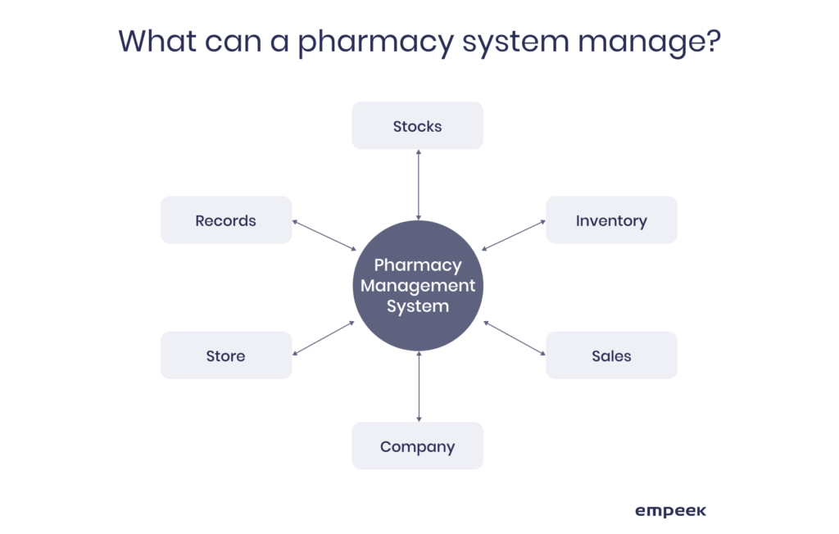
SYSTEM ARCHITECTURE

Slide 10
SOFTWARE REQUIREMENTS
Java Development Kit (JDK) version 8 or above.
Integrated Development Environment (IDE) such as Eclipse or NetBeans.
MySQL server version 5.6 or above.
MySQL Connector/J library for Java.
Apache Tomcat server.

Slide 11
HARDWARE REQUIREMENTS
Processor: Intel Core i5 or higher.
RAM: 4GB or higher.
Hard disk space: 20GB or higher.
Operating System: Windows, Linux, or Mac OS.

Slide 12
SYSTEM DESIGN
System design is the process of defining the architecture, components, modules, interfaces, and data for a software system to satisfy specified requirements.
It involves the creation of a blueprint or a plan that outlines the structure and behavior of the system.

Slide 13
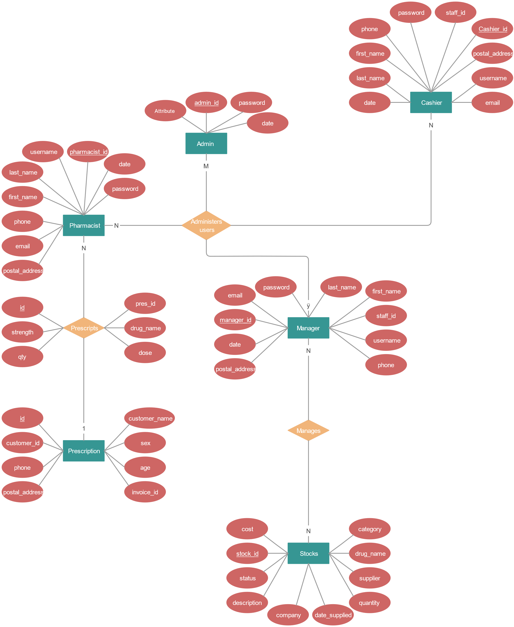
E-R DIAGRAM

Slide 14
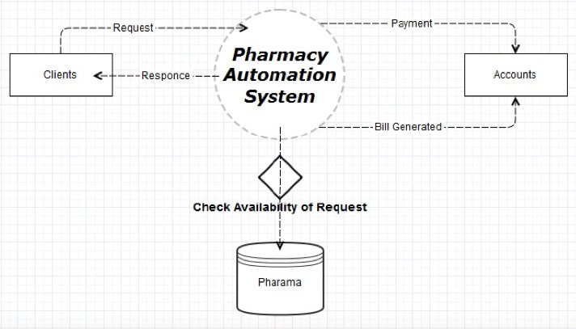
DATA FLOW DIAGRAM

Slide 15
CONCLUSION
In conclusion, an online pharmacy management system developed using Java and MySQL can provide an efficient and reliable solution for managing pharmacy operations.
The system can enable pharmacists to manage drug inventory, patient records, billing, and other critical functions. By leveraging Java's object-oriented programming capabilities and MySQL's robust relational database management system, developers can create a system that is scalable, flexible, and secure.

Slide 16
THANK YOU

